Slide 1
Decision Tree and Random Forest
Some material adopted from notes by Chuck Dyer

Slide 2
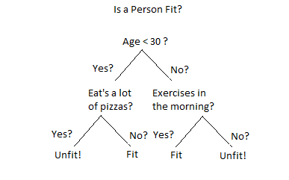
Decision Tree
Decision trees
  A decision tree is a decision support tool that uses a tree-like graph or model of decisions.
  It is one way to display an algorithm that only contains conditional control statements.
  Partition the instance space into axis-parallel regions, labeled with class value

Slide 3
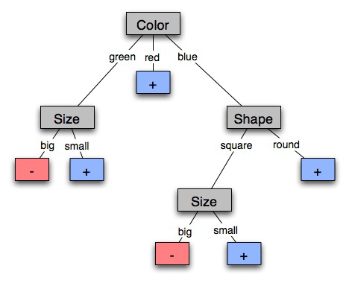
Learning Decision Trees
Goal: Build a decision tree to classify examples as positive or negative instances of a concept using supervised learning from a training set
A decision tree is a tree where
  each non-leaf node has associated with it an attribute (feature)
  each leaf node has associated with it a classification (+ or -)
  each arc has associated with it one of the possible values of the attribute at the node from which the arc is directed
Generalization: allow for >2 classes
  e.g., {sell, hold, buy}

Slide 4

Example of a Decision Tree
Refund
Yes
No
NO
MarSt
Single, Divorced
Married
TaxInc
NO
< 80K
> 80K
NO
YES
Training Data
Model: Decision Tree

Slide 5

Apply Model to Test Data
Test Data
Start at the root of tree
Refund
Yes
No
NO
MarSt
Single, Divorced
Married
TaxInc
NO
< 80K
> 80K
NO
YES

Slide 6
Apply Model to Test Data
Test Data
Refund
Yes
No
NO
MarSt
Single, Divorced
Married
TaxInc
NO
< 80K
> 80K
NO
YES

Slide 7

Apply Model to Test Data
Test Data
Refund
Yes
No
NO
MarSt
Single, Divorced
Married
TaxInc
NO
< 80K
> 80K
NO
YES

Slide 8
Apply Model to Test Data
Test Data
Refund
Yes
No
NO
MarSt
Single, Divorced
Married
TaxInc
NO
< 80K
> 80K
NO
YES

Slide 9

Apply Model to Test Data
Test Data
Refund
Yes
No
NO
MarSt
Single, Divorced
Married
TaxInc
NO
< 80K
> 80K
NO
YES

Slide 10
Apply Model to Test Data
Test Data
Refund
Yes
No
NO
MarSt
Single, Divorced
Married
Assign Cheat to “No”
TaxInc
NO
< 80K
> 80K
NO
YES

Slide 11
Information Theory
Information is measured in bits
Information conveyed by a message depends on its probability
With n equally probable possible messages, the probability p of each is 1/n
Information conveyed by message is log₂(n) = -log₂(p)
  e.g., with 16 messages, then log₂ (16) = 4 and we need 4 bits to identify/send each message
Given probability distribution for n messages P = (p₁,p₂…p_{n}), the information conveyed by distribution (aka entropy of P) is:
  I(P) = -(p₁*log₂ (p₁) + p₂*log₂ (p₂) + .. + p_{n}*log₂ (p_{n}))
probability of msg 2
info in msg 2

Slide 12
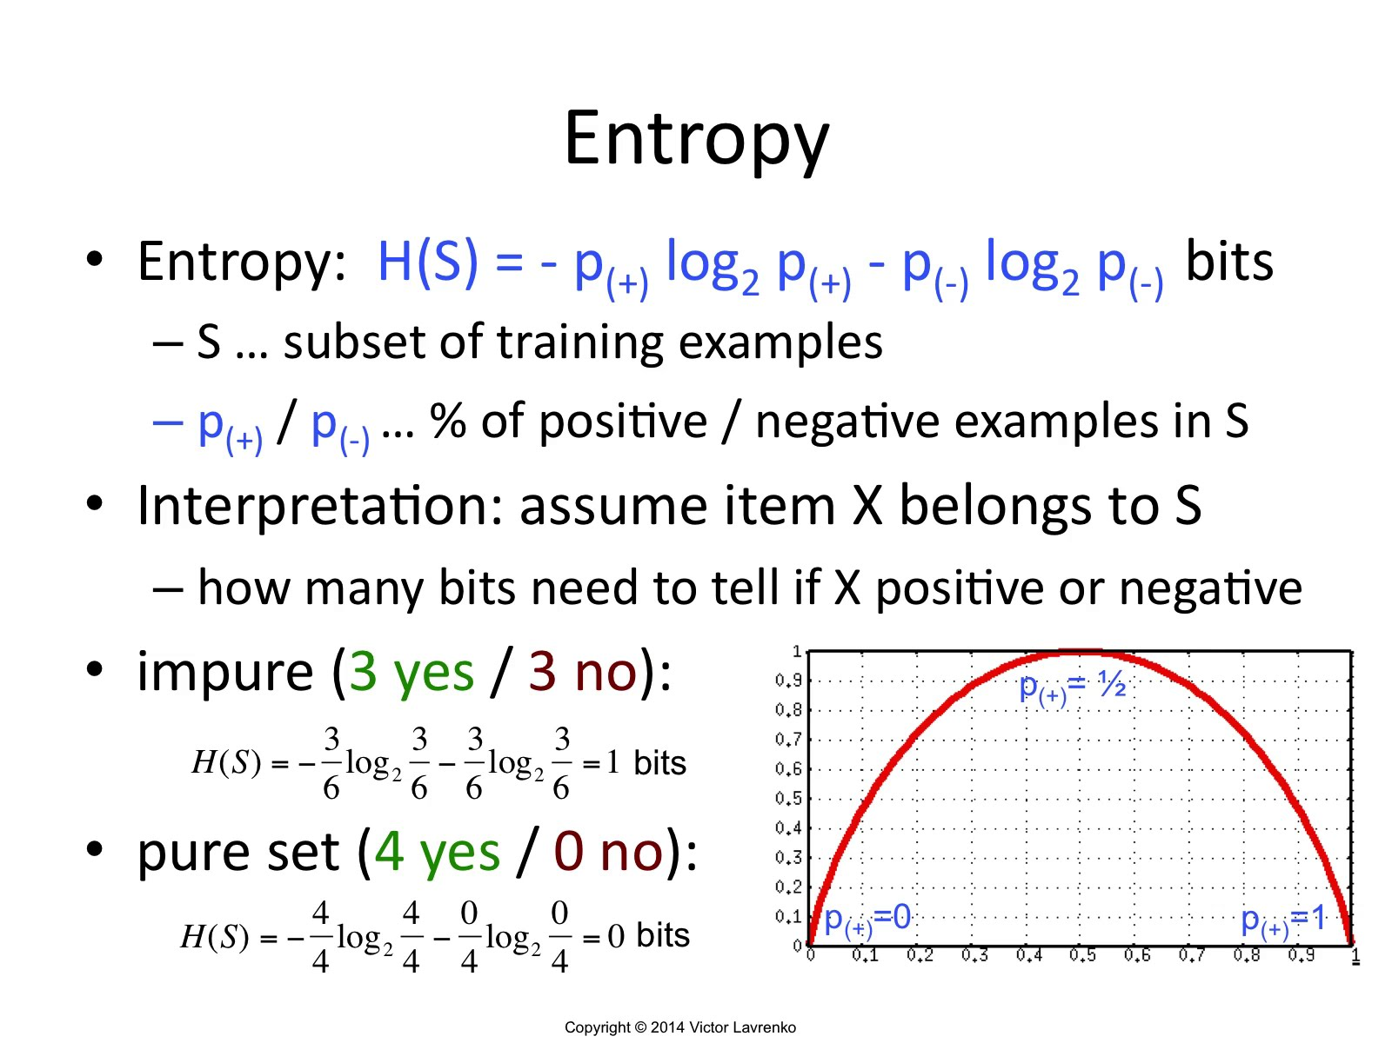


Slide 13
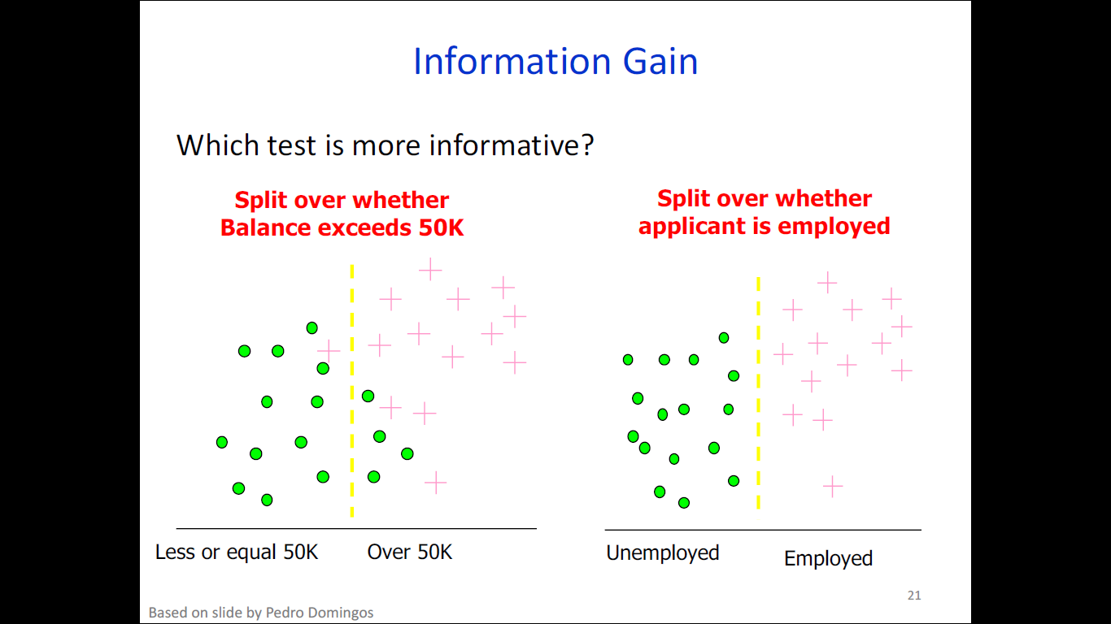

Slide 14
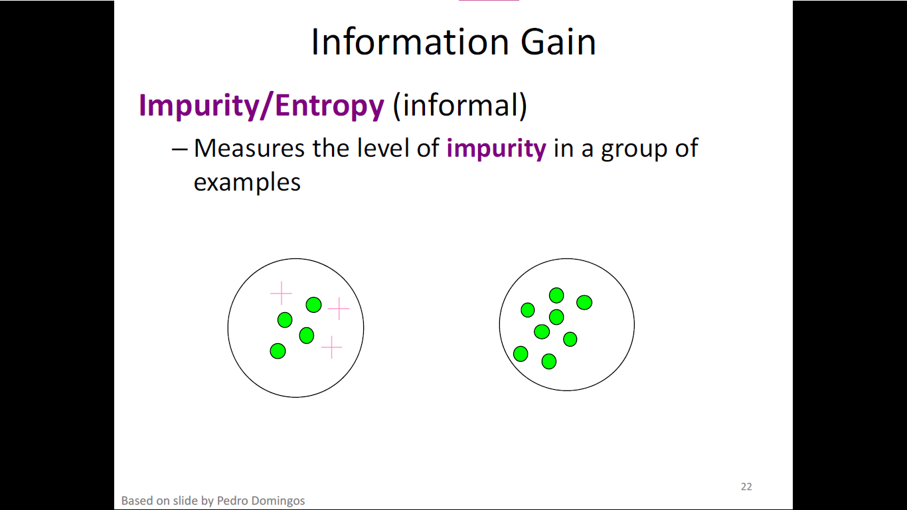

Slide 15
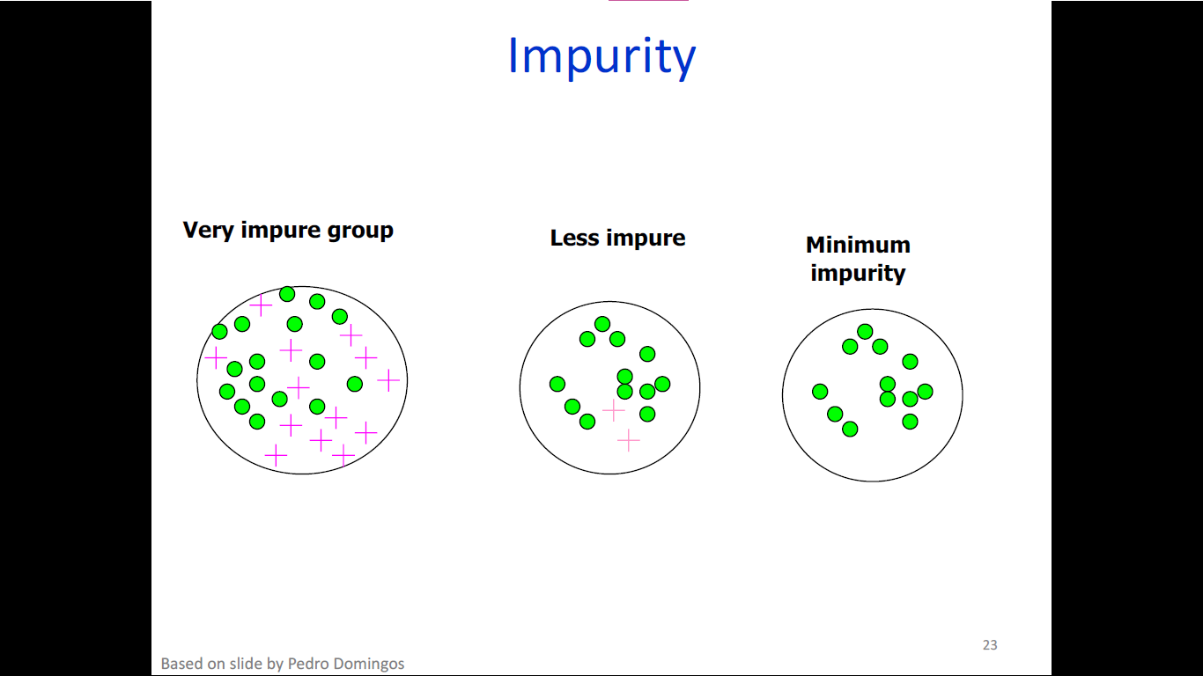

Slide 16
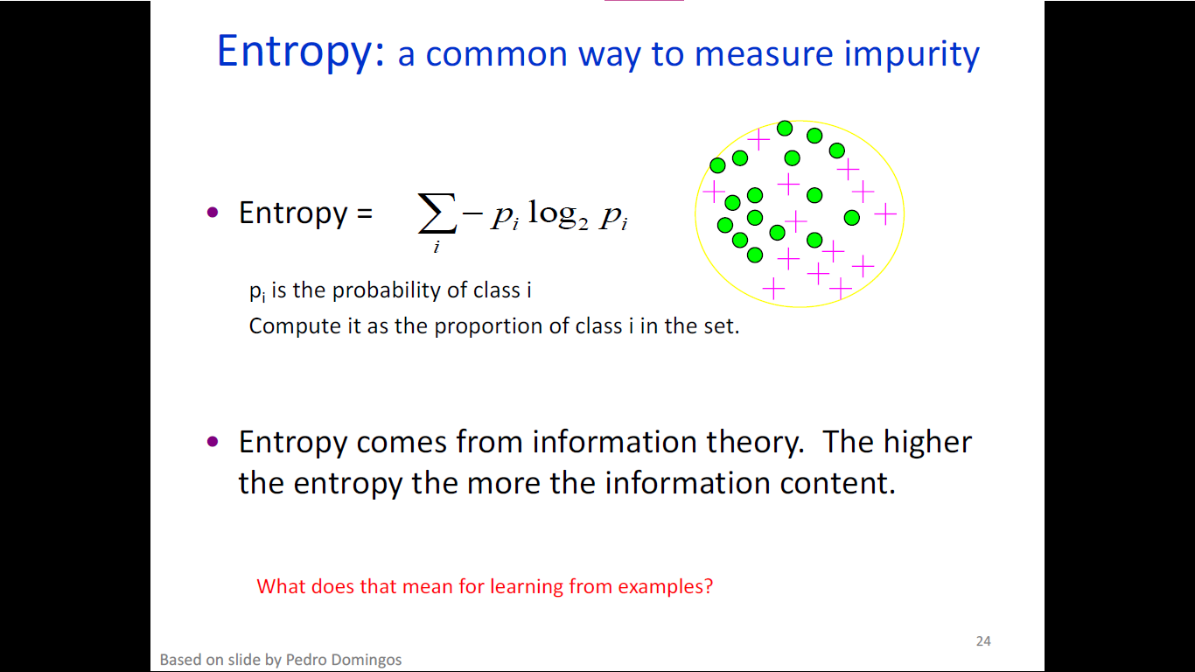

Slide 17
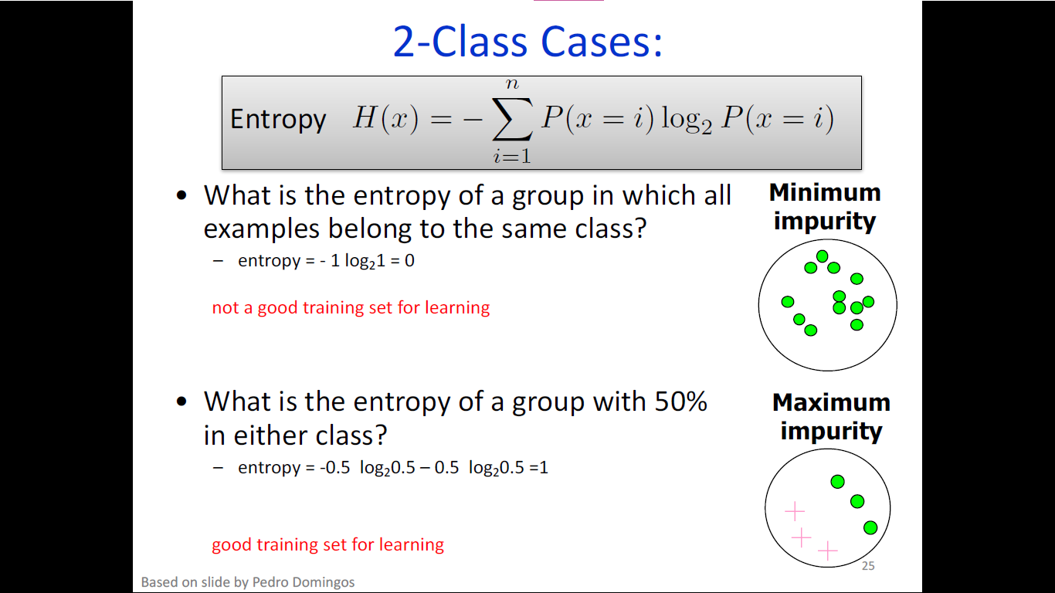

Slide 18
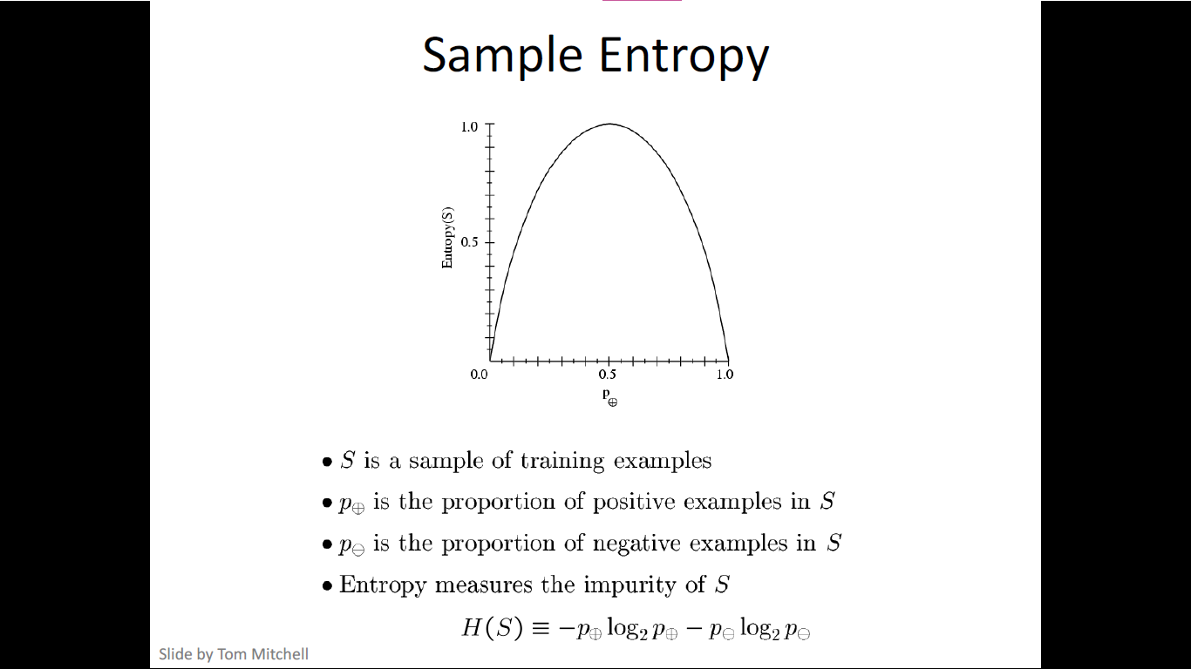

Slide 19
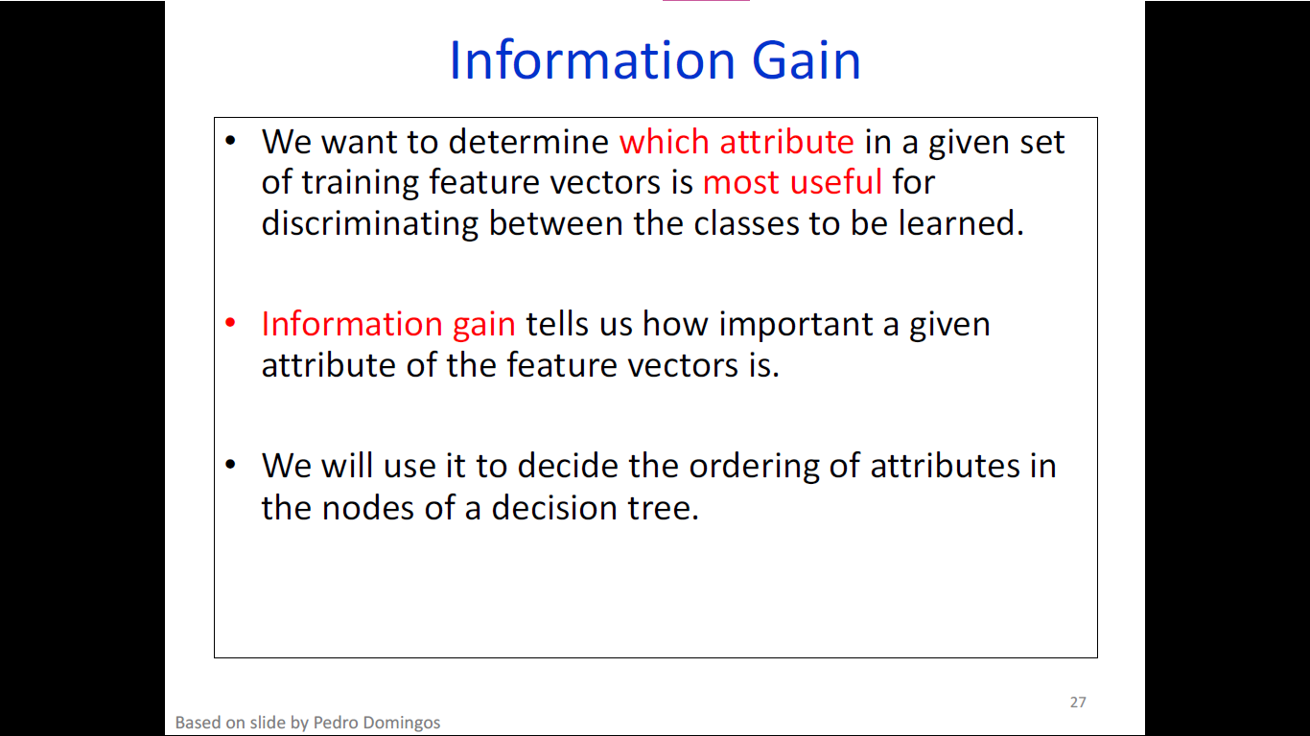

Slide 20
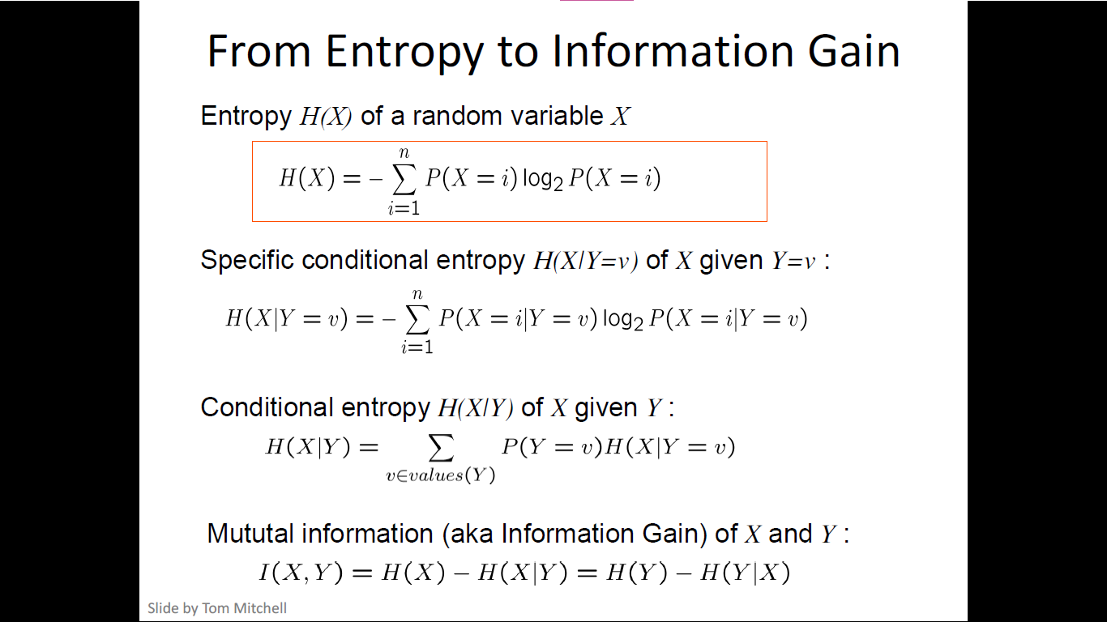

Slide 21
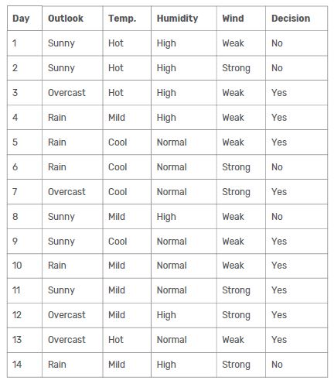
Decision Tree

Slide 22

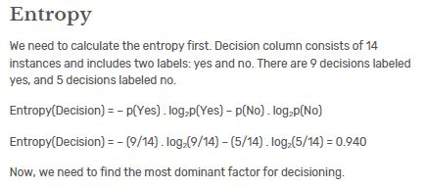
Decision Tree
We can summarize the ID3 algorithm as illustrated below

Slide 23
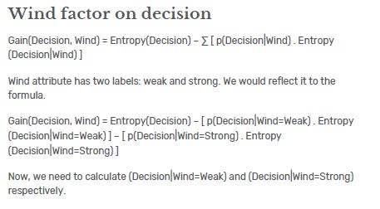
Decision Tree

Slide 24
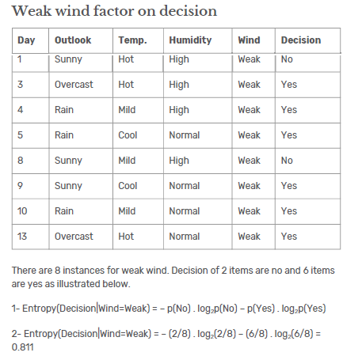
Decision Tree

Slide 25
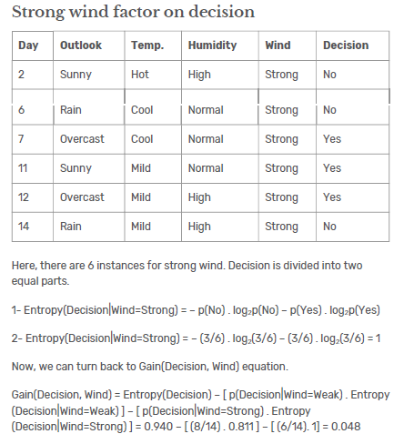
Decision Tree

Slide 26
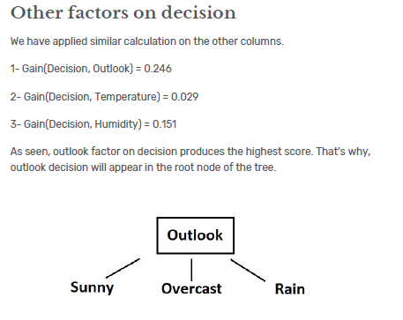
Decision Tree

Slide 27
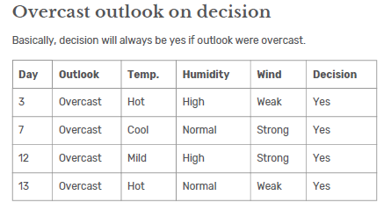
Decision Tree

Slide 28
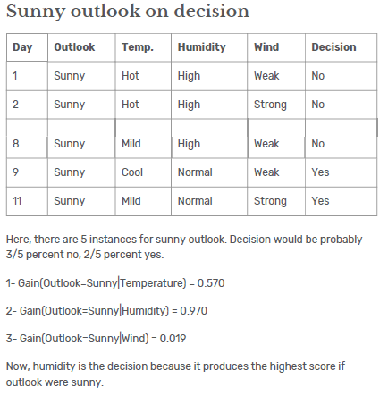
Decision Tree

Slide 29
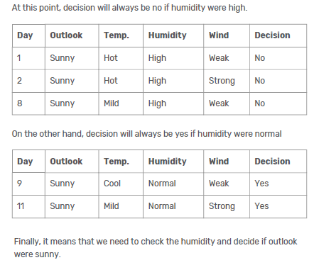
Decision Tree

Slide 30
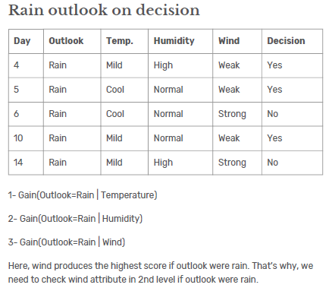
Decision Tree

Slide 31
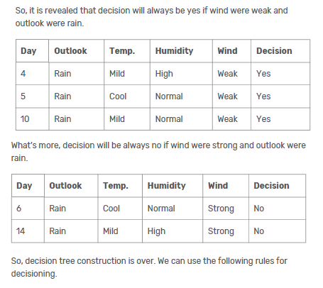
Decision Tree

Slide 32
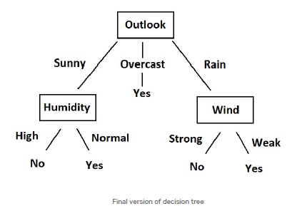
Decision Tree

Slide 33
Extensions of the Decision Tree Learning Algorithm
Using gain ratios
Real-valued data
Noisy data and overfitting
Generation of rules
Setting parameters
Cross-validation for experimental validation of performance
C4.5 is an extension of ID3 that accounts for unavailable values, continuous attribute value ranges, pruning of decision trees, rule derivation, and so on

Slide 34
Summary: Decision Tree Learning
Inducing decision trees is one of the most widely used learning methods in practice
Can out-perform human experts in many problems
Strengths include
  Fast
  Simple to implement
  Can convert result to a set of easily interpretable rules
  Empirically valid in many commercial products
  Handles noisy data
Weaknesses include:
  Univariate splits/partitioning using only one attribute at a time so limits types of possible trees
  Large decision trees may be hard to understand
  Requires fixed-length feature vectors
  Non-incremental (i.e., batch method)

